Slide 1
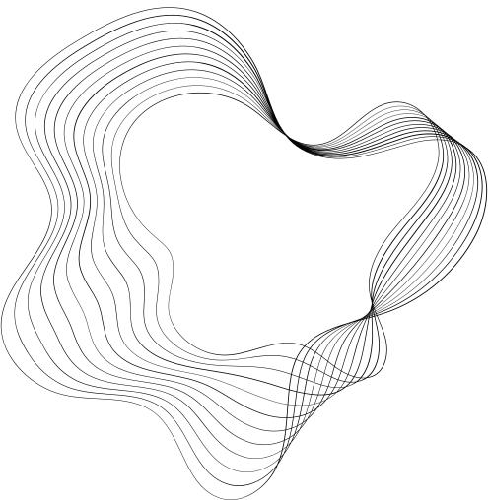

NOISE POLLUTION MONITORING SYSTEM

Slide 2
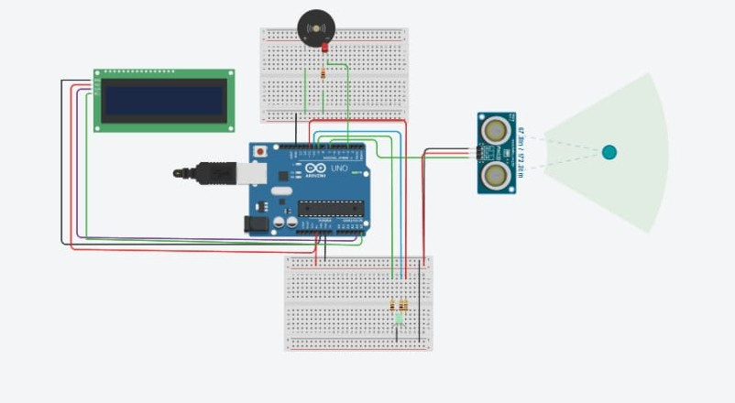
The above circuit diagram shows noise pollution monitoring system circuit is designed to measure and assess environmental noise levels. It typically includes a microphone or sound sensor to capture sound, an amplification stage to boost the weak signals, and an analog-to-digital converter (ADC) to convert the analog signal into digital data. A microcontroller processes this data and may display real-time noise levels on an LCD or transmit them wirelessly for remote monitoring. It may also have an alert system to trigger warnings when noise levels exceed predefined limits. Proper grounding and shielding techniques are important to ensure accurate measurements, and regular calibration is necessary to maintain the system's accuracy and reliability.

Slide 3
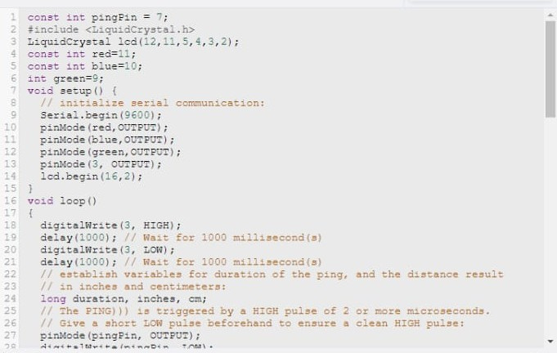

Slide 4
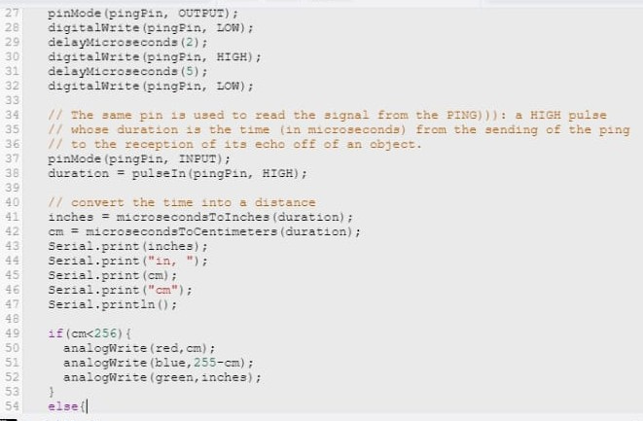

Slide 5
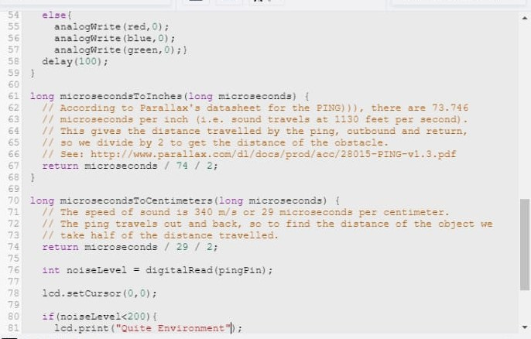

Slide 6
